Slide 1
Zoonoses Online Education Project Online courses with videos for the field of veterinary communication dealing with prevention, diagnosis and treatment of diseases transferable from animals to humans Ref. no.: 2016-1-RO01-KA203-024732
PROJECT PRESENTATION
This project has been funded with the support from the European Union. This material reflects the views only of the author, and the Commission cannot be held responsible for any use which may be made of the information contained therein.

Slide 2
The Funding Programme
Programme: Erasmus+
Key Action: Cooperation for innovation and the exchange of good practices
Action: Strategic Partnerships
Field: Strategic Partnerships for higher education
Monitoring institution: RO National Agency
Project period – October 2016 – March 2019

Slide 3
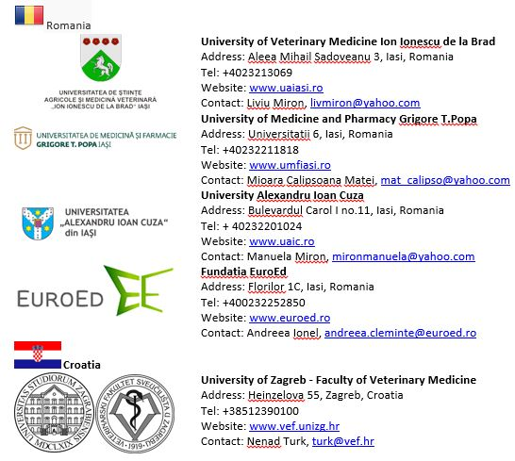
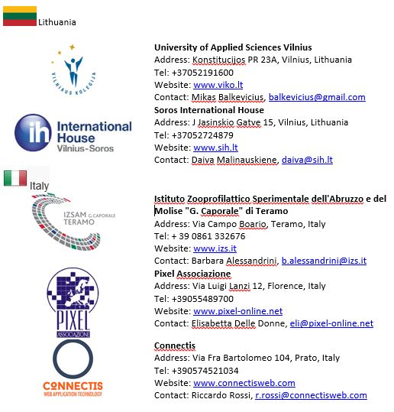
Project Partnership

Slide 4
The Context
International organizations and associations have drawn attention to two major health risks: malaria and dirofilariosis.
The World Health Organization and the World Bank rank malaria as a major public health problem in parts of Asia, Latin America, the Middle East, Eastern Europe and the Pacific. More than a million people die of malaria each year; although malaria is a preventable disease, a child dies of malaria every 30 seconds.
Each year at least 2 million people become infected with bacteria that are resistant to antibiotics and at least 23,000 people die each year as a direct result of these infections. Over 23% of dogs on EU are the hosts of dirofilaria, which causes pulmonary dirofilariosis in humans.

Slide 5
The main aim of the project
The project aims to create open digital educational resources in the field of veterinary medicine based on developing innovative guidelines on zoonotic diseases study
and
veterinary, medical, pedagogical, linguistic and raise awareness intervention related to identify, monitor and control malaria & dirofilosis,
useful for the academic, professional & general beneficiaries.

Slide 6
Impact
Project brings together 5 educational sectors, all with impact in 5 different end beneficiaries groups
Lectures, (foreign) students and professionals in the field of veterinary
Zoonoses
Veterinary medicine
Human medicine
Pedagogy
Pre-university education
Languages – Medical communication
Raise awareness to general public
Lectures, (foreign) students and professionals in the field of medicine (Health Care and Epidemiology)
Teachers and future teachers, lectures and students of Pedagogy
Lectures, (foreign) students and professionals in the field of medicine & veterinary
Pupils ages 6-12, parents;
Patients, families or animals owners

Slide 7
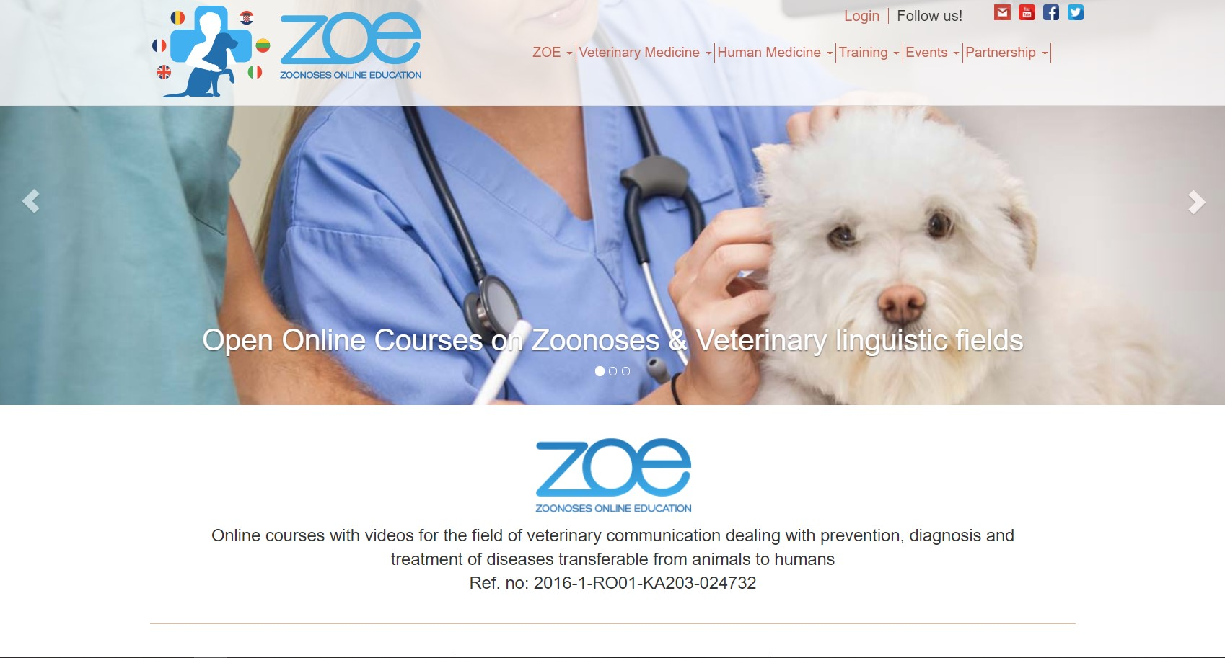
Project Portal – www.zoeproject.eu

Slide 8
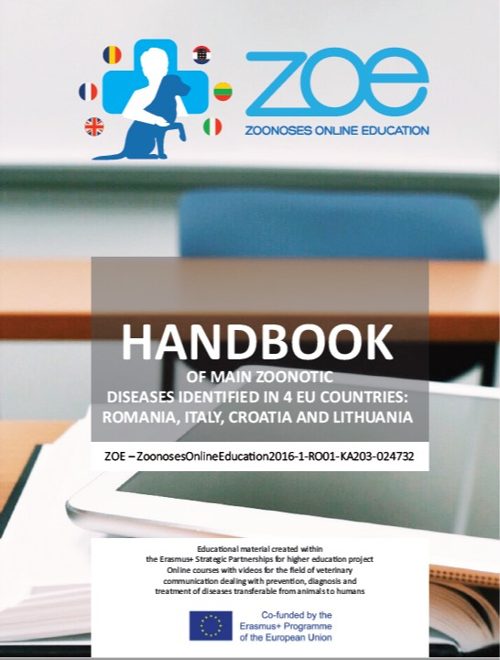
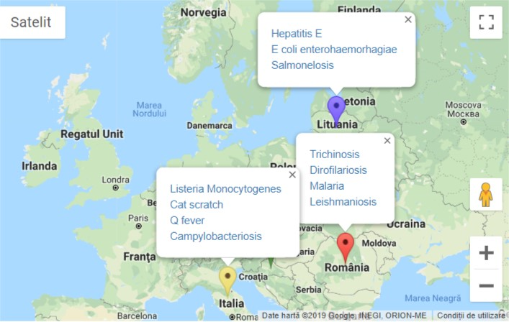
Project Activities and Results (1)
Handbook of main Zoonotic Diseases identified in 4 EU countries: Romania, Italy, Croatia, Lithuania - http://zoeproject.eu/zoonoses_state_of_arts.php

Slide 9
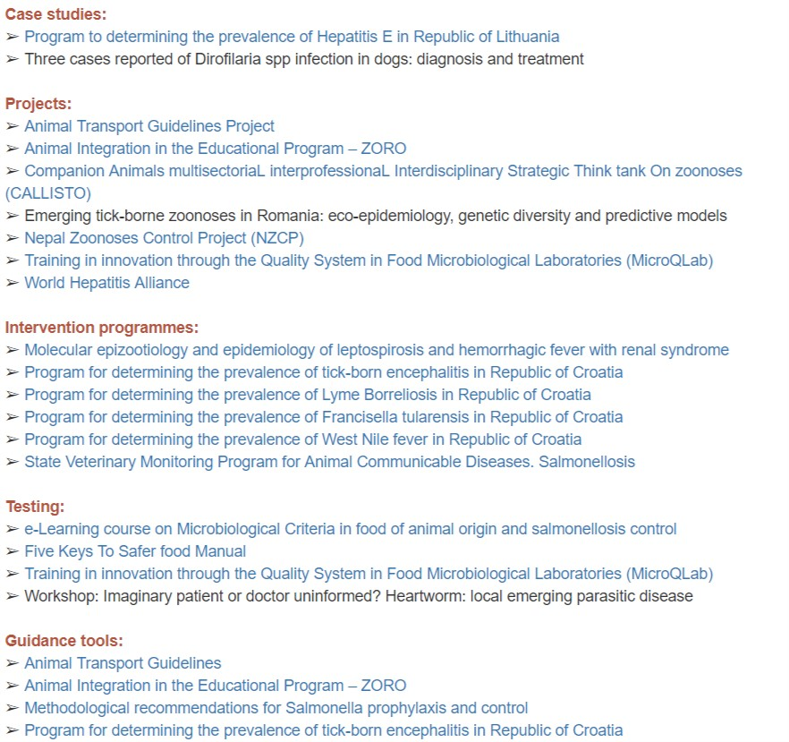
Project Activities and Results (2)
Best practices on reducing the risk of infectious diseases transmitted from non-human animals to humans and to provide examples of new tools for diagnosis, prevention and therapy.
http://zoeproject.eu/best_practices.php

Slide 10
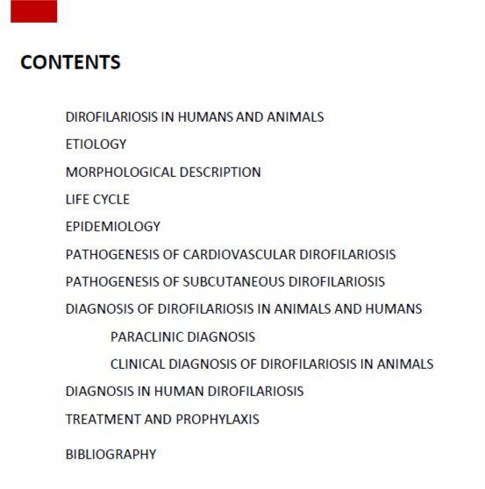
Project Activities and Results (3)
Guide of main infectious diseases transmitted from non-human animals to humans – Malaria in humans and animals
http://zoeproject.eu/study_of_malaria.php
Guide of main infectious diseases transmitted from non-human animals to humans – Dirofilariosis in humans and animals
http://zoeproject.eu/study_of_dirofilaria.php
Available in English, Romanian, French, Lithuanian, Italian, Croatian.

Slide 11
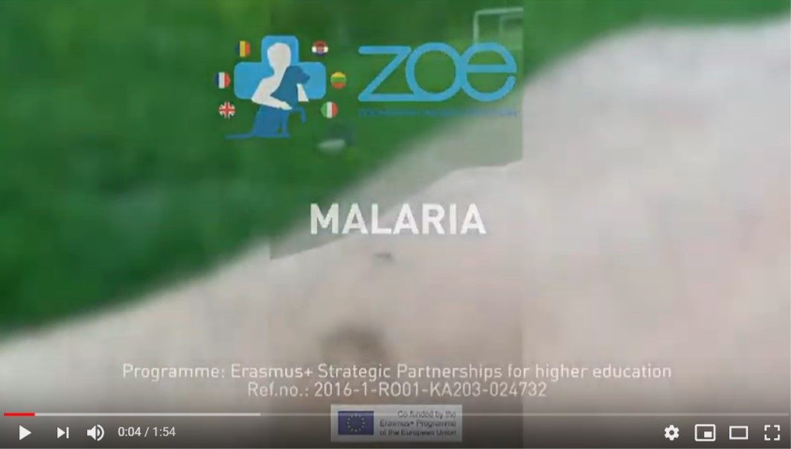
Project Activities and Results (4)
Videos capturing zoonoses bio-manipulation in simulation centers – Malaria
https://youtu.be/akfB-Te_yl8
Videos capturing zoonoses bio-manipulation in simulation centers – Dirofilariosis
https://youtu.be/_6dawrxbSNU

Slide 12
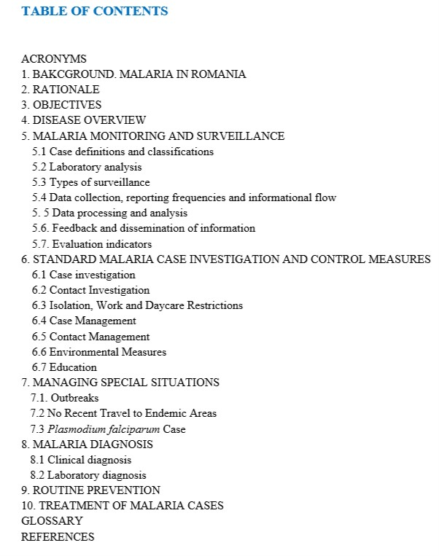
Project Activities and Results (5)
PROTOCOL on epidemiological monitoring and disease control in public health practice - Malaria
http://zoeproject.eu/epidemiological_monitoring.php

Slide 13
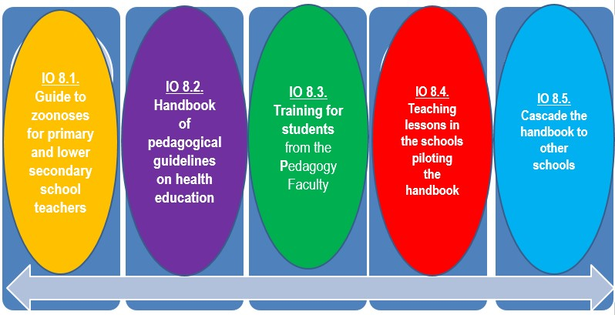
Project Activities and Results (6)
Handbook of pedagogical guidelines on health education
http://zoeproject.eu/pedagogical_guidelines.php

Slide 14
Project Activities and Results (7)
Open On-Line Courses - Language course for the veterinary medical field http://zoeproject.eu/course/login.php
The Language Course offers the study of 8 units, all with specific reference to the malaria and dirofilariosis diseases:
- Unit 1 - Definition of zoonoses
- Unit 2 - Etiology
- Unit 3 - Epidemiology
- Unit 4 - Pathogenesis
- Unit 5 - Clinical manifestations
- Unit 6 - Diagnostic
- Unit 7 - Prophylaxis
- Unit 8 - Treatment
English
French
Romanian
Italian
Croatian
Lithuanian

Slide 15
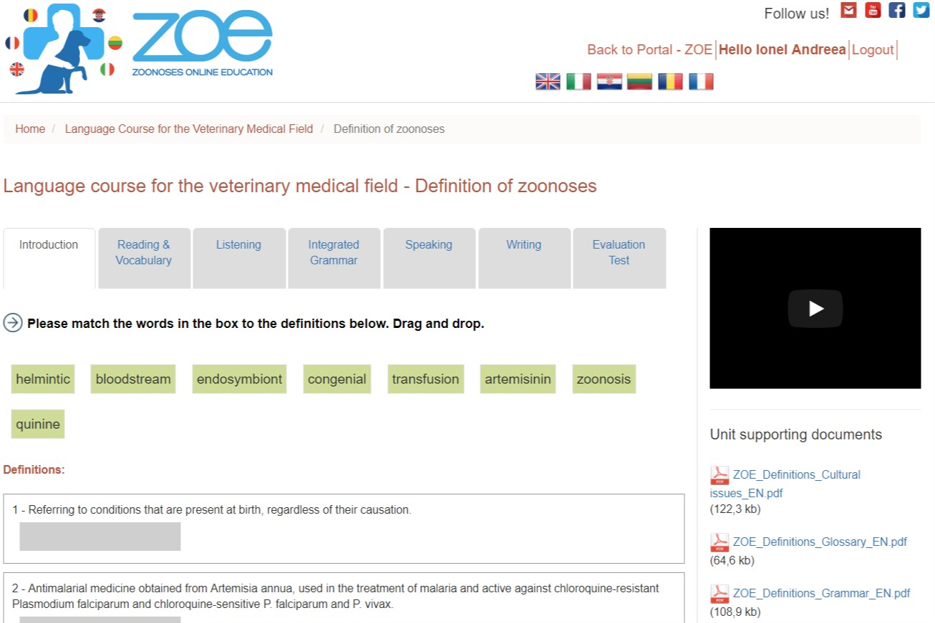
Project Activities and Results (7)
Open On-Line Courses - Language course for the veterinary medical field
http://zoeproject.eu/course/login.php

Slide 16
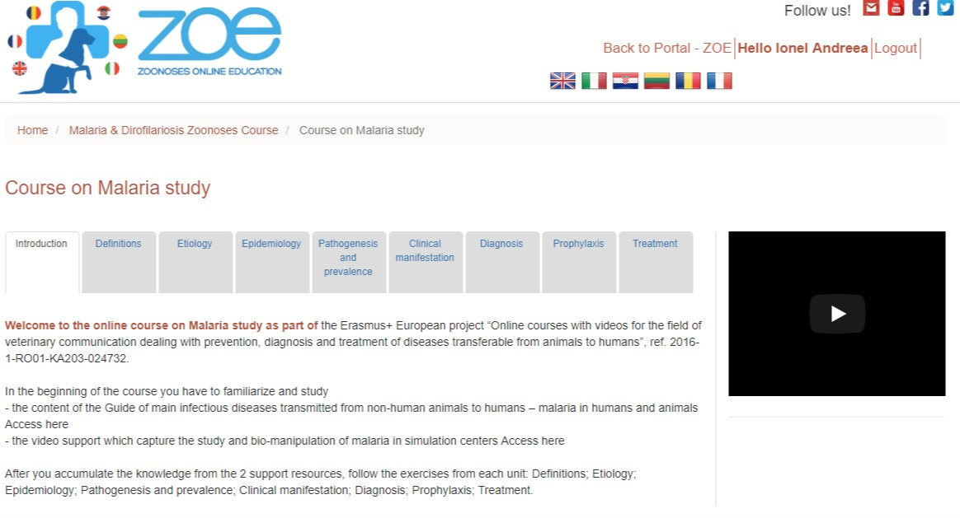
Project Activities and Results (8)
Open On-Line Courses - The Zoonoses course on malaria & dirofilariosis study,
http://zoeproject.eu/course/login.php

Slide 17
Project Activities and Results (9)
Training activities
http://zoeproject.eu/training_activities.php

Slide 18
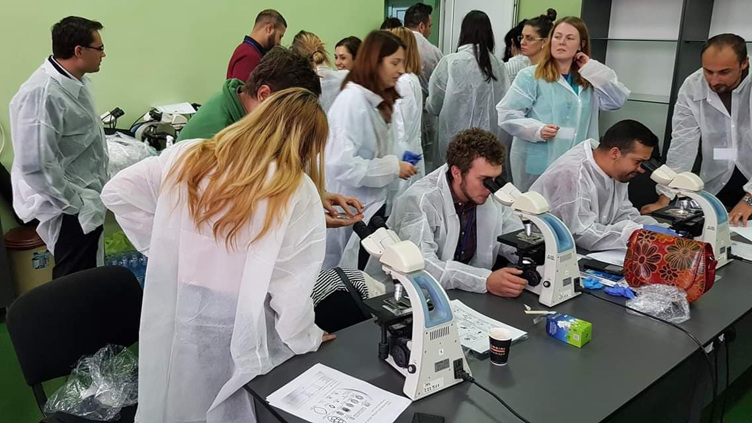
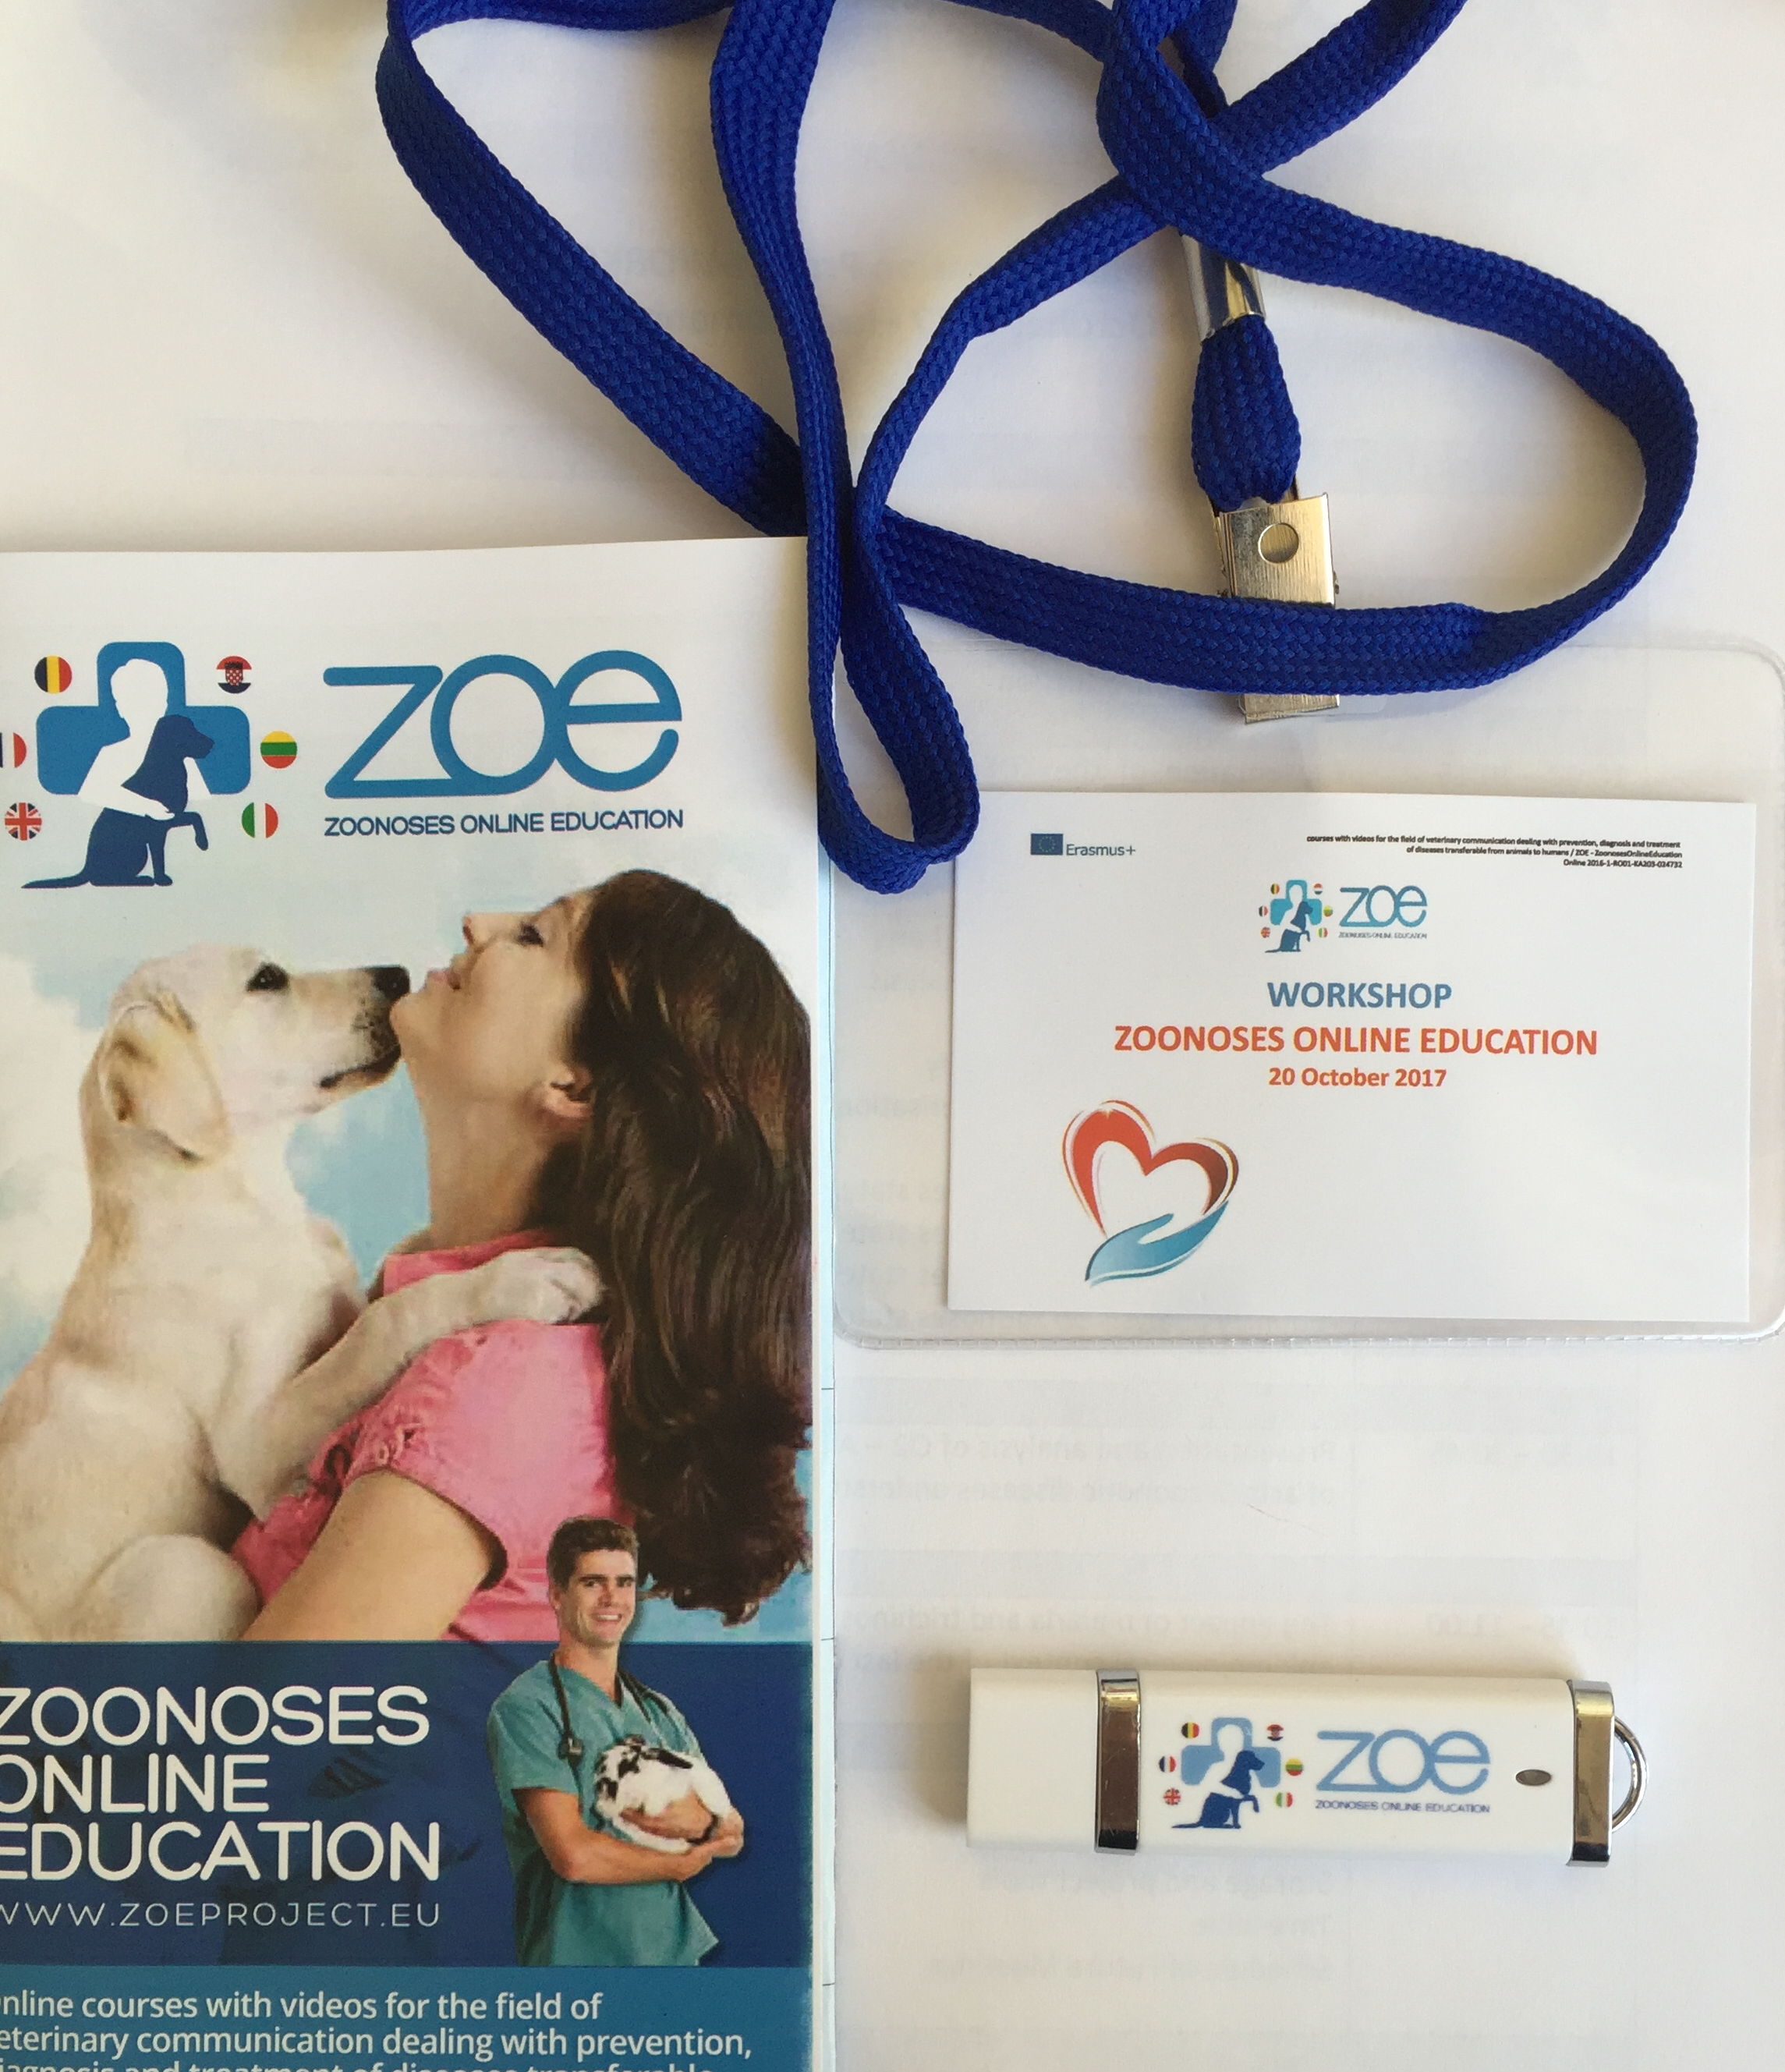
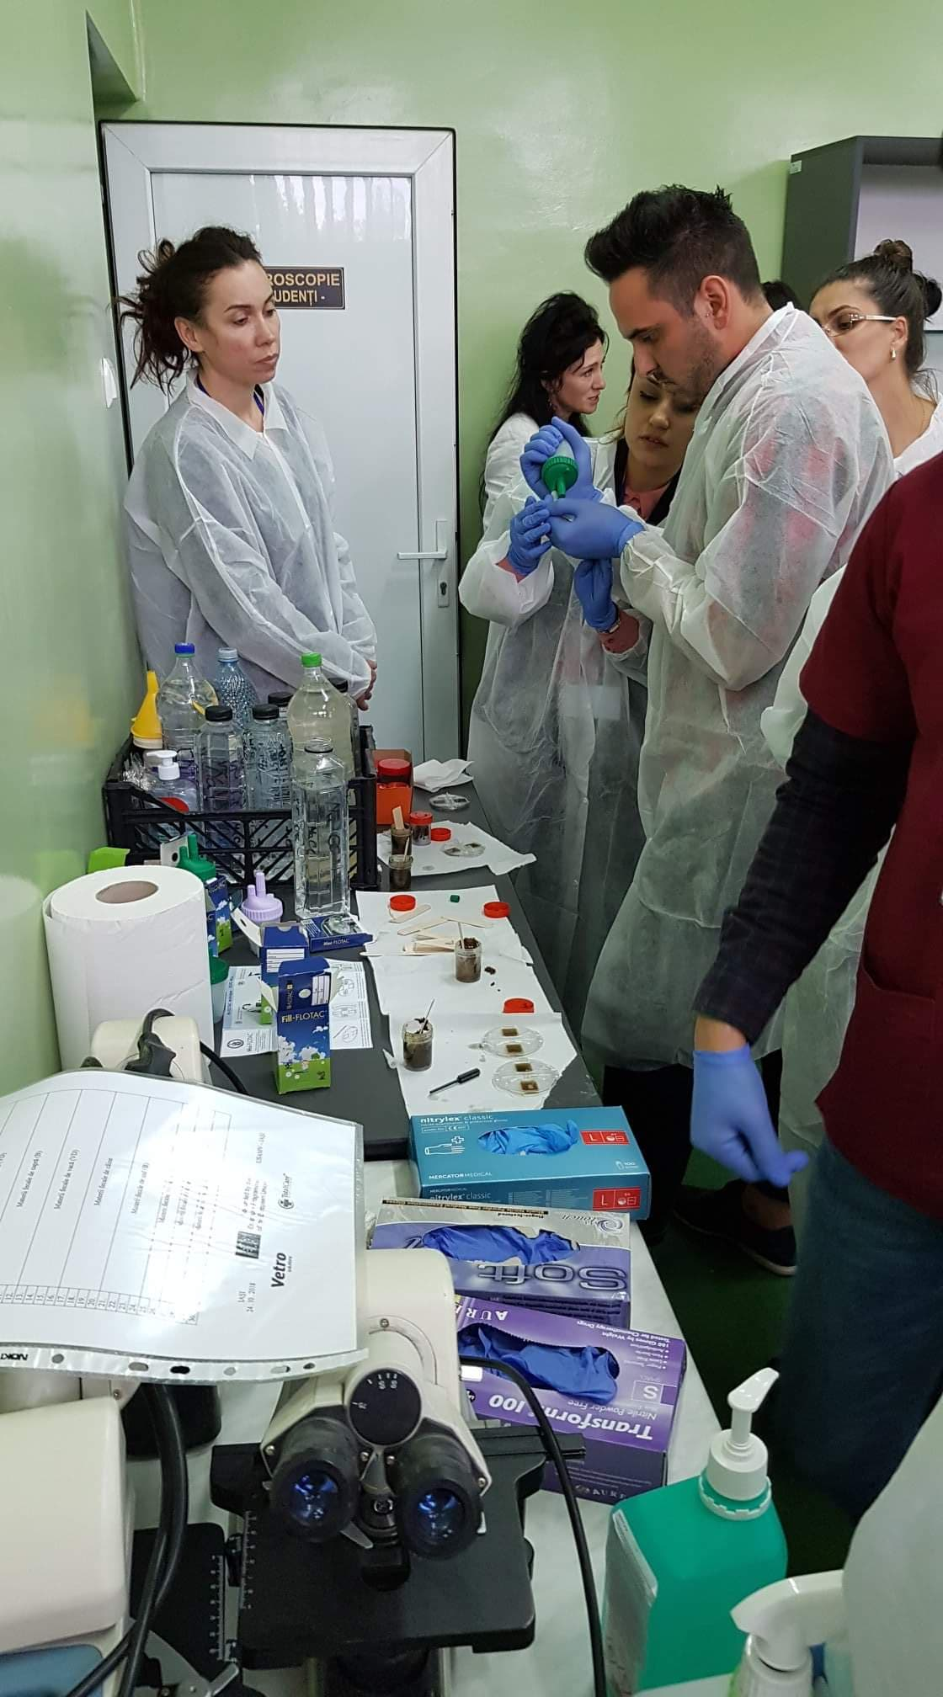
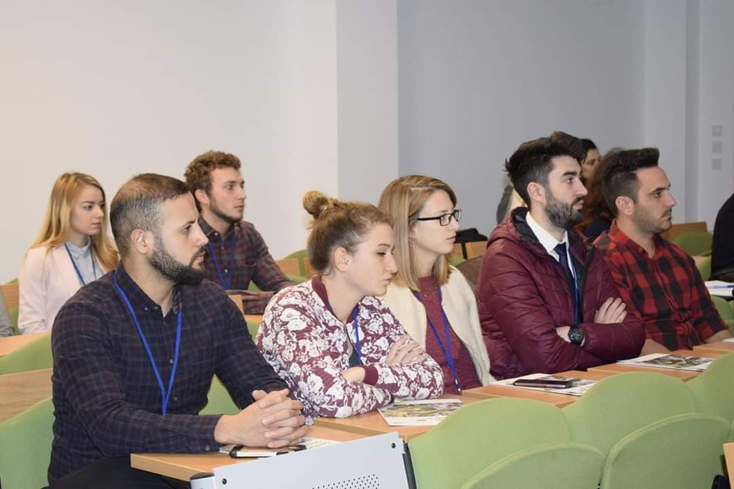
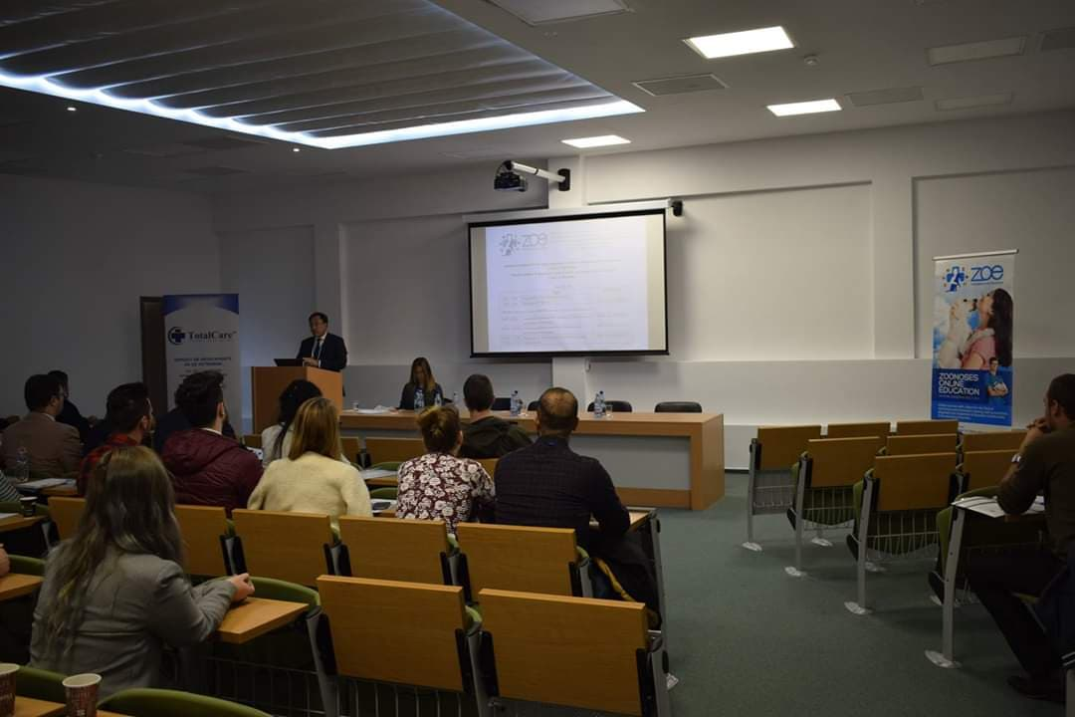
Trainings with Students on Veterinary Guidelines

Slide 19
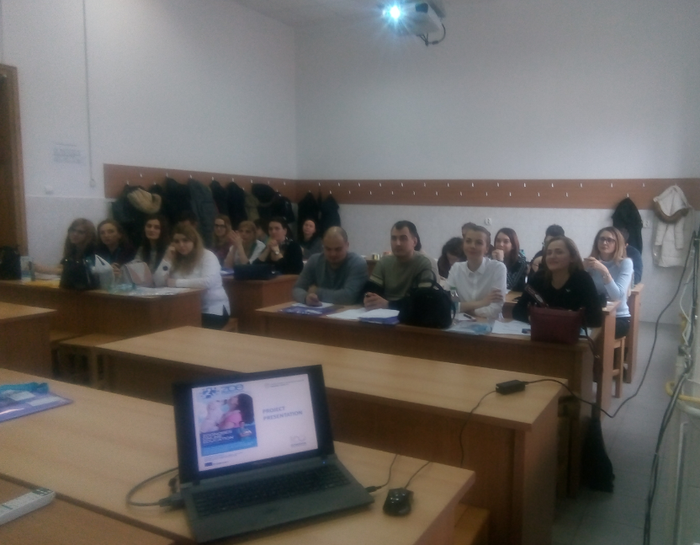
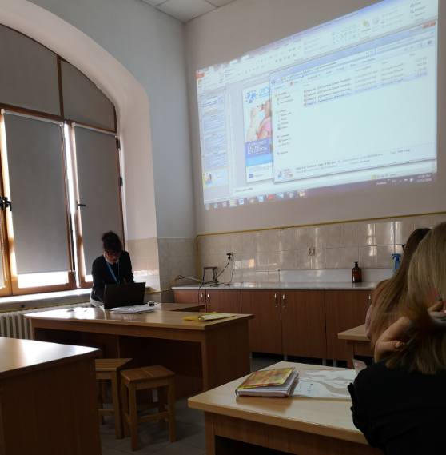
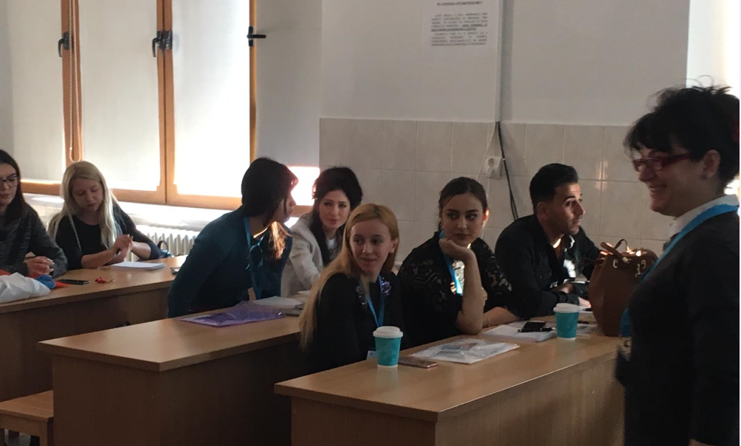
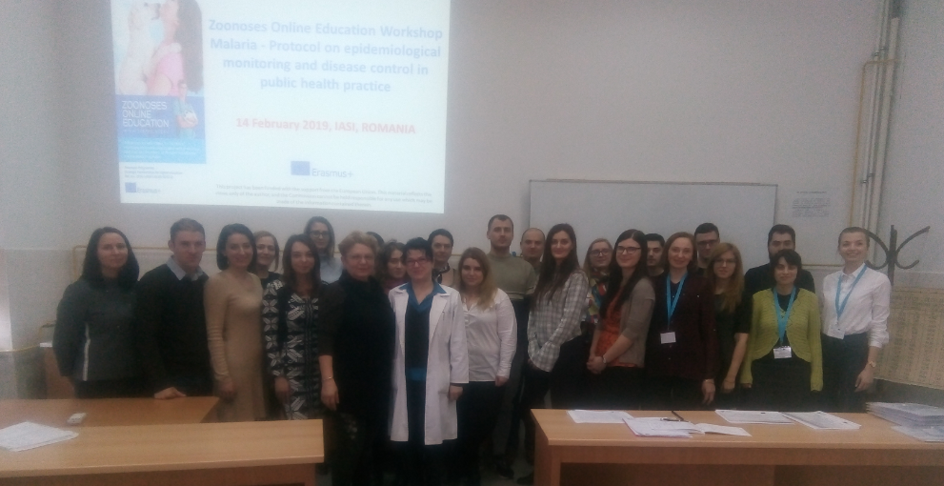
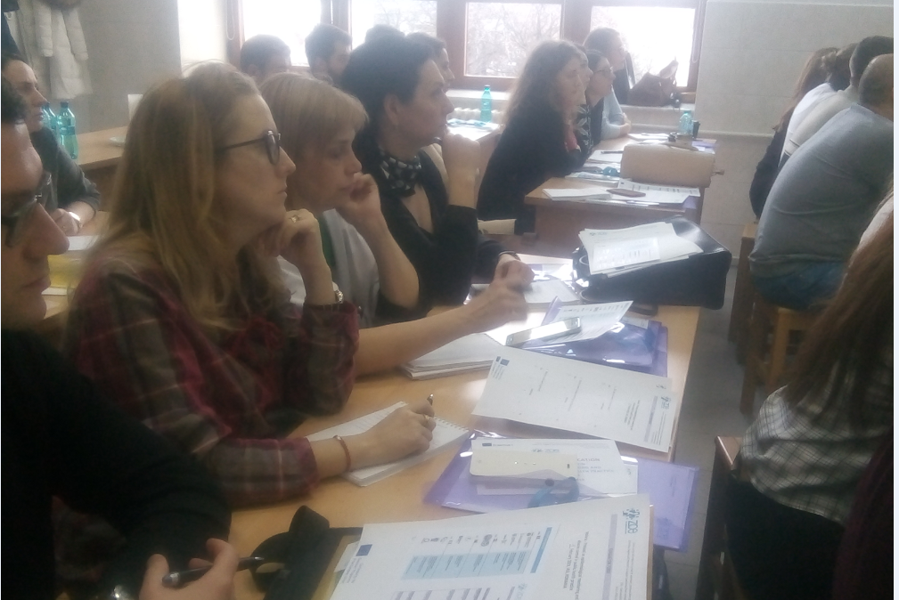
Trainings with Students on PROTOCOL on epidemiological monitoring and disease control in public health practice - Malaria

Slide 20
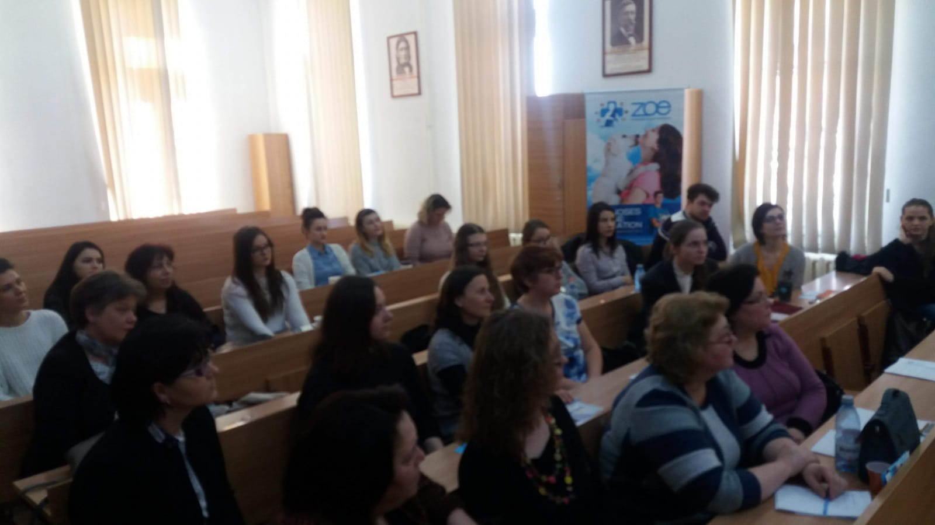
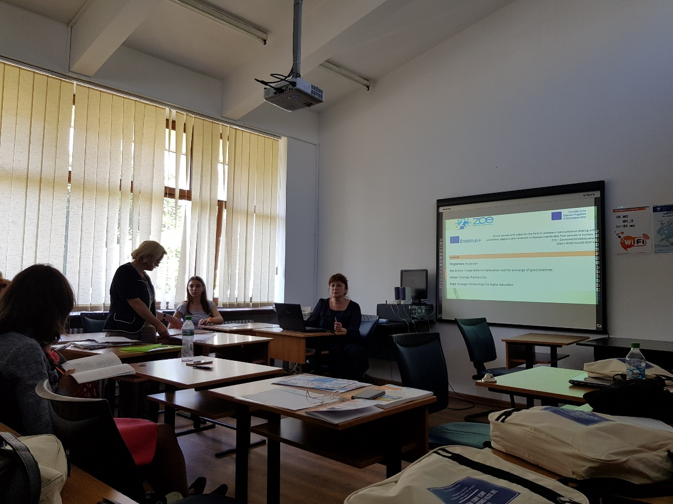
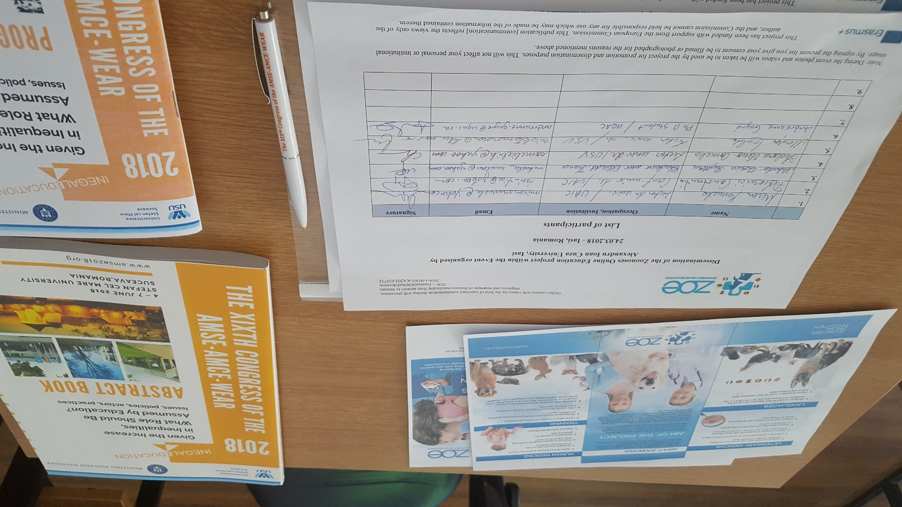
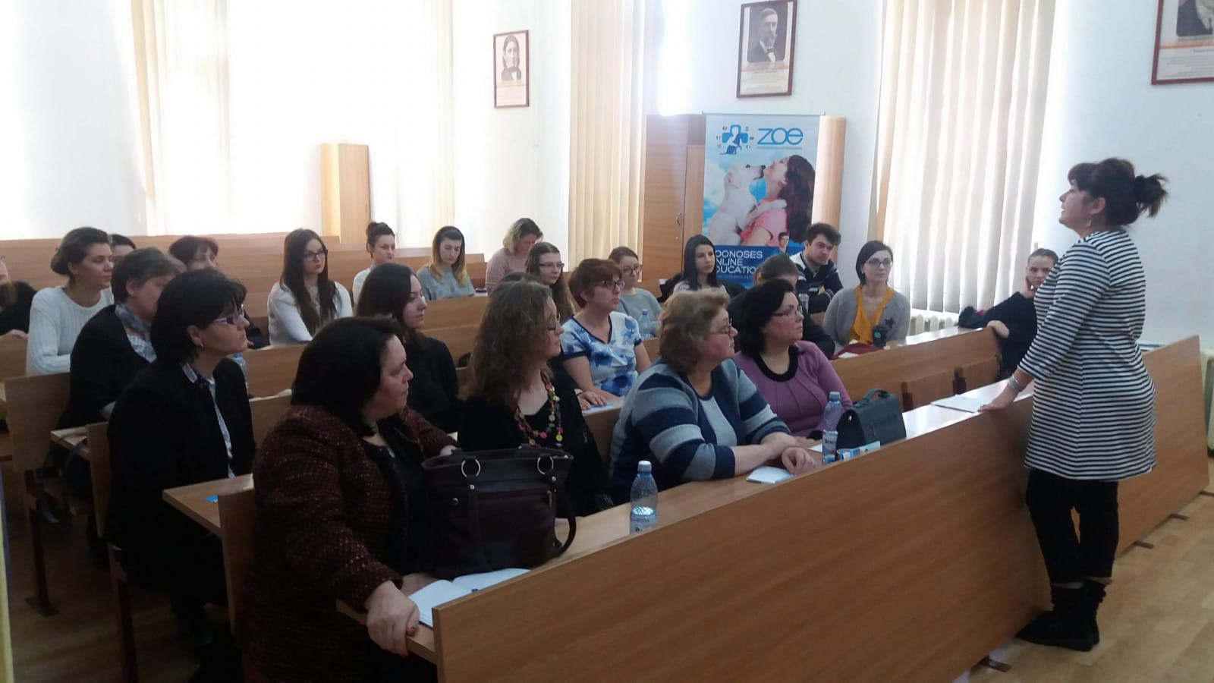
Trainings with students and teachers on the Handbook of pedagogical guidelines on health education

Slide 21
Zoonoses Online Education Project Online courses with videos for the field of veterinary communication dealing with prevention, diagnosis and treatment of diseases transferable from animals to humans Ref. no.: 2016-1-RO01-KA203-024732
www.zoeproject.eu
This project has been funded with the support from the European Union. This material reflects the views only of the author, and the Commission cannot be held responsible for any use which may be made of the information contained therein.

